Slide 1
Java 2
Exam 1 Study Guide

Slide 2
Sorting
Linear Scans

Slide 3
Properties of Sorts
Comparison sort: The only assumption about the data being sorted is that the data elements can be compared to each other on the basis of “less than”-­ that is, a total order exists.
In-place: The list itself is rearranged and only a constant amount of extra space is required.
Adaptive: Running time is affected by initial state of input.
Stable: Equal elements maintain the same relative order.
All four sorts are comparison sorts
 | Selection | Insertion | Mergesort | Quicksort
In-place | Yes | Yes | No | Yes
Stable | No | Yes | Yes | No
Adaptive | No | Yes | No | No

Slide 4
Selection Sort Example Loop
Best Case: O(N²)
Worst Case: O(N²)
Average: O(N²)
Searches the given data each iteration for the next (smallest) value.
Once a value is placed it is sorted.
As it moves values temporarily it is NOT STABLE.
Will always have O(N²) time complexity so it is NOT ADAPTIVE.
Keeps all values in the loop so it is In-place.
[1, 6, 3, 5, 8, 9, 4, 2, 7] Start
[1, 6, 3, 5, 8, 9, 4, 2, 7] 1
[1, 2, 3, 5, 8, 9, 4, 6, 7] 2
[1, 2, 3, 5, 8, 9, 4, 6, 7] 3
[1, 2, 3, 4, 8, 9, 5, 6, 7] 4
[1, 2, 3, 4, 5, 9, 8, 6, 7] 5
[1, 2, 3, 4, 5, 6, 8, 9, 7] 6
[1, 2, 3, 4, 5, 6, 7, 9, 8] 7
[1, 2, 3, 4, 5, 6, 7, 8, 9] 8
[1, 2, 3, 4, 5, 6, 7, 8, 9] 9

Slide 5
Insertion Sort Example Loop
Best Case: O(N)
Worst Case: O(N²)
Average: O(N²)
Sorts the data by making a subarray where the elements are sorted as they are added.
Because there is no addition array Insertion sort is in-place.
It is stable because duplicate values would be added to the list in the same order they were in naturally.
As the list is more sorted it takes less time so it is Adaptive.
[5, 9, 1, 6, 2, 3, 4, 7, 8] Start
[5, 9, 1, 6, 2, 3, 4, 7, 8] 1
[1, 5, 9, 6, 2, 3, 4, 7, 8] 2
[1, 5, 6, 9, 2, 3, 4, 7, 8] 3
[1, 2, 5, 6, 9, 3, 4, 7, 8] 4
[1, 2, 3, 5, 6, 9, 4, 7, 8] 5
[1, 2, 3, 4, 5, 6, 9, 7, 8] 6
[1, 2, 3, 4, 5, 6, 7, 9, 8] 7
[1, 2, 3, 4, 5, 6, 7, 8, 9] 8

Slide 6
Sorting
Divide and conquer

Slide 7
Merge Sort Example
Best case: O(N log N)
Average case: O(N log N)
Worst case: O(N log N)
Breaks down the data into single pieces and then starts the comparasions.
When combining the pieces they are ordered.
Uses a temporay array which means it is NOT IN-PLACE.
It is stable because duplicate values would not move positions and would in their natural position.
It has the same time complexity meaning it is not adaptive to any data set.
[1, 6, 3, 5, 8, 9, 4, 2, 7]
[1, 6, 3, 5, 8, 4, 9, 2, 7]
[1, 3, 5, 6, 8, 2, 4, 7, 9]
[1, 2, 3, 4, 5, 6, 7, 8, 9]

Slide 8
Quick Sort
Best case: O(N log N)
Average case: O(N log N)
Worst case: O(N²).
Doesn’t sort the elements in order, only compares them to the pivot in each iteration.
Less than the pivot puts an element randomly on the left side while being greater than puts you on the right side.
Worst case is when the pivot leaves only one partition each time
Since no order is persevered it is NOT STABLE.
Worst case is not based on sorted size but pivot placement so it is NOT ADAPTIVE.
Since there are no additional temporary storages it is in-place
[1, 6, 3, 5, 8, 9, 4, 2, 7]
^
|
pivot
[1, 4, 3, 2, 5, 6, 9, 7, 8]

Slide 9
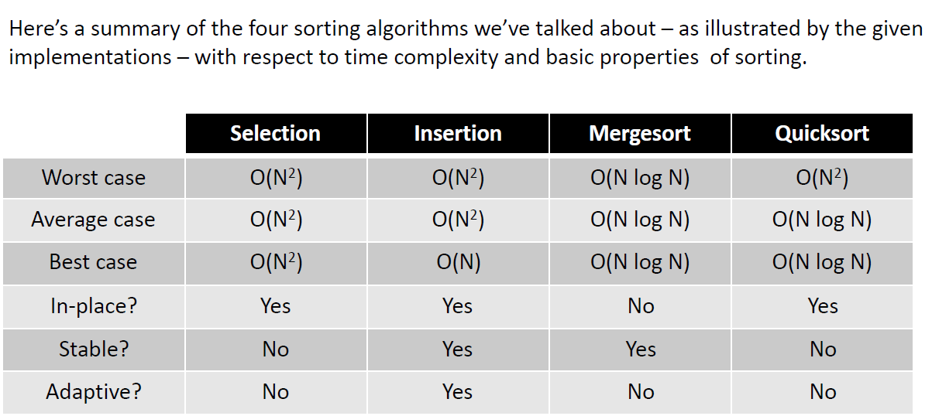
Sorting at a Glance

Slide 10
Algorithm Analysis Efficiency (Time Complexity)

Slide 11
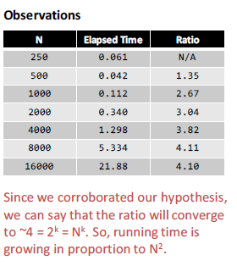
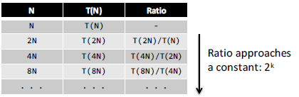
Time Complexity – Empirical analysis
Ratio between T(2N) / T(N) will approach a constant (c) equal to
c = 2^{k} = N^{k}

Slide 12
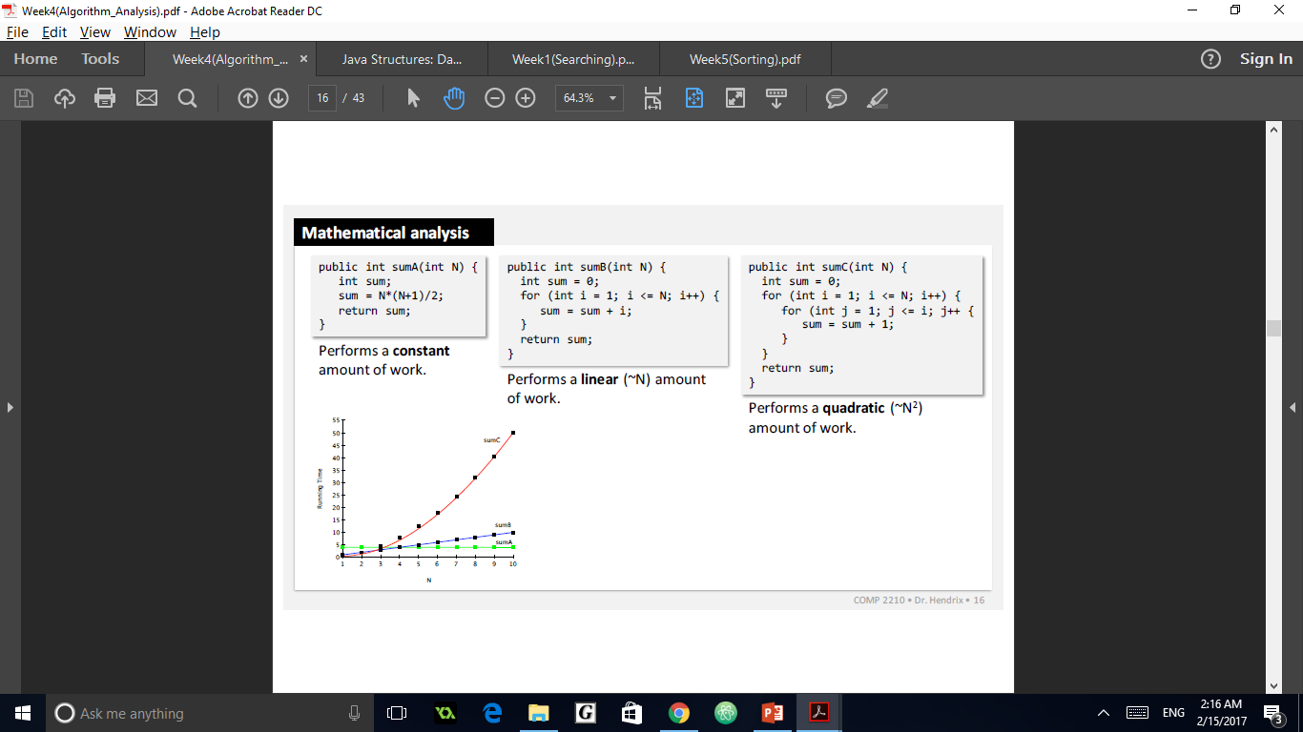
Time Complexity - Code
For x loops using N there is time complexity of O(N^{x}).
No loop so there is O(C) time complexity .
One loop using N so time complexity is O(N)
Two loops dependent on N so time complexity is O(N²). The more loops dependent on N the higher time complexity.

Slide 13
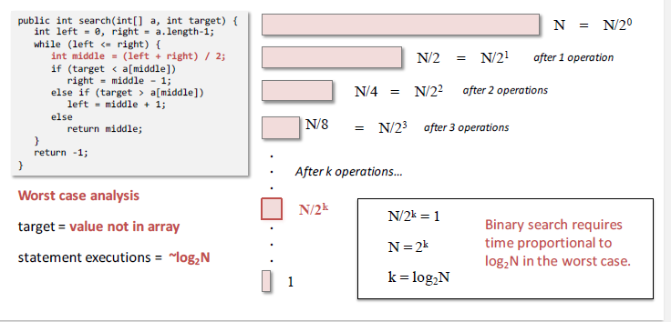
Time Complexity – Binary Search
Since your cutting down on the number of element you search each iteration you do less work.
What you are dividing your counter by will the x in log_{x}N

Slide 14
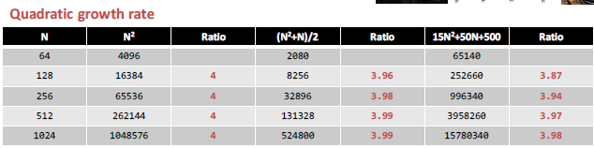

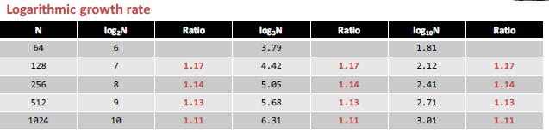
Growth Rates

Slide 15
Early Exits
In situations where you are only looking for a specific element adding a early exit greatly increases the time efficiency.
This can make a difference

Slide 16
Generality, Correctness, and Searching

Slide 17
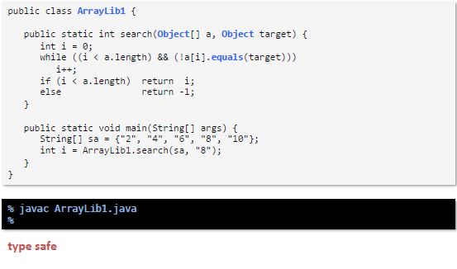
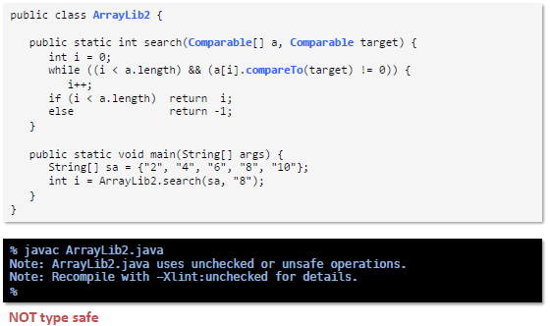
Type Safety
A Java program is considered type safe if there are no definite or potential type errors identified by the compiler.

Slide 18
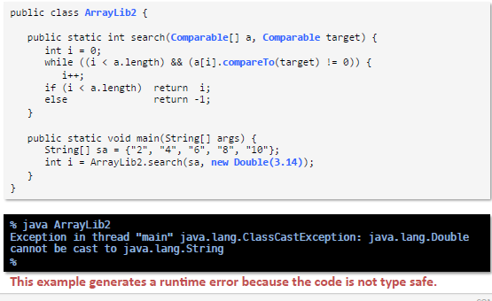
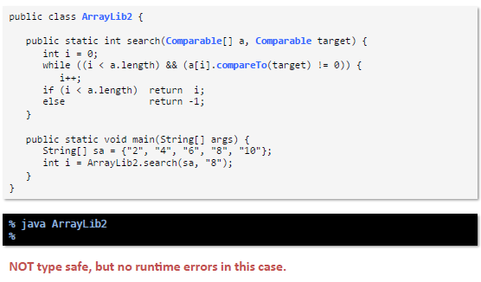
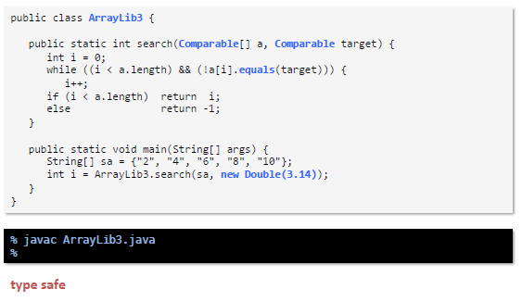
Type Safety Cont.

